Slide 1
Understanding Agentic Development
Maria Naggaga
Jeremy Likness

Slide 2



From Chat to Agents
Chats
AI Agents
Generation
Generate summaries, images, audio, and more with an AI model and inputs.
Retrieval
Retrieve information from grounding data, reason, summarize, and answer user questions
Actions
Take actions to automate workflows, and replace repetitive tasks for users

Slide 3







What is an agent?
Agent
LLM
LLM
Input
Output
Instructions
Instructions
Tools
System events
User messages
Agent messages
Tools
Agent messages
Tool results
Tool calls
Retrieval
Actions
Memory
Notes:
An AI agent is a simple program where you allow an LLM to help you decide the control flow of the program. It is like a micro-service that can execute tasks and achieve specific business outcomes.
just like microservices, you can update or fine-tune an agent without having to rebuild the whole system. Even if our applications aren’t literally a collection of tiny agents coordinating with each other, thinking in these terms helps us focus on modularity and scalability. It’s all about having a unit of logic that's easy to optimize and improve over time.
What makes an agent different from traditional software s its ability to handle unstructured, multi-modal input, it uses the LLM to decide which tool to invoke.

Slide 4

Demo: Agentic Development with Microsoft Agent Framework in .NET

Slide 5
Executors
Edges
Workflows
Agents
Events

Slide 6
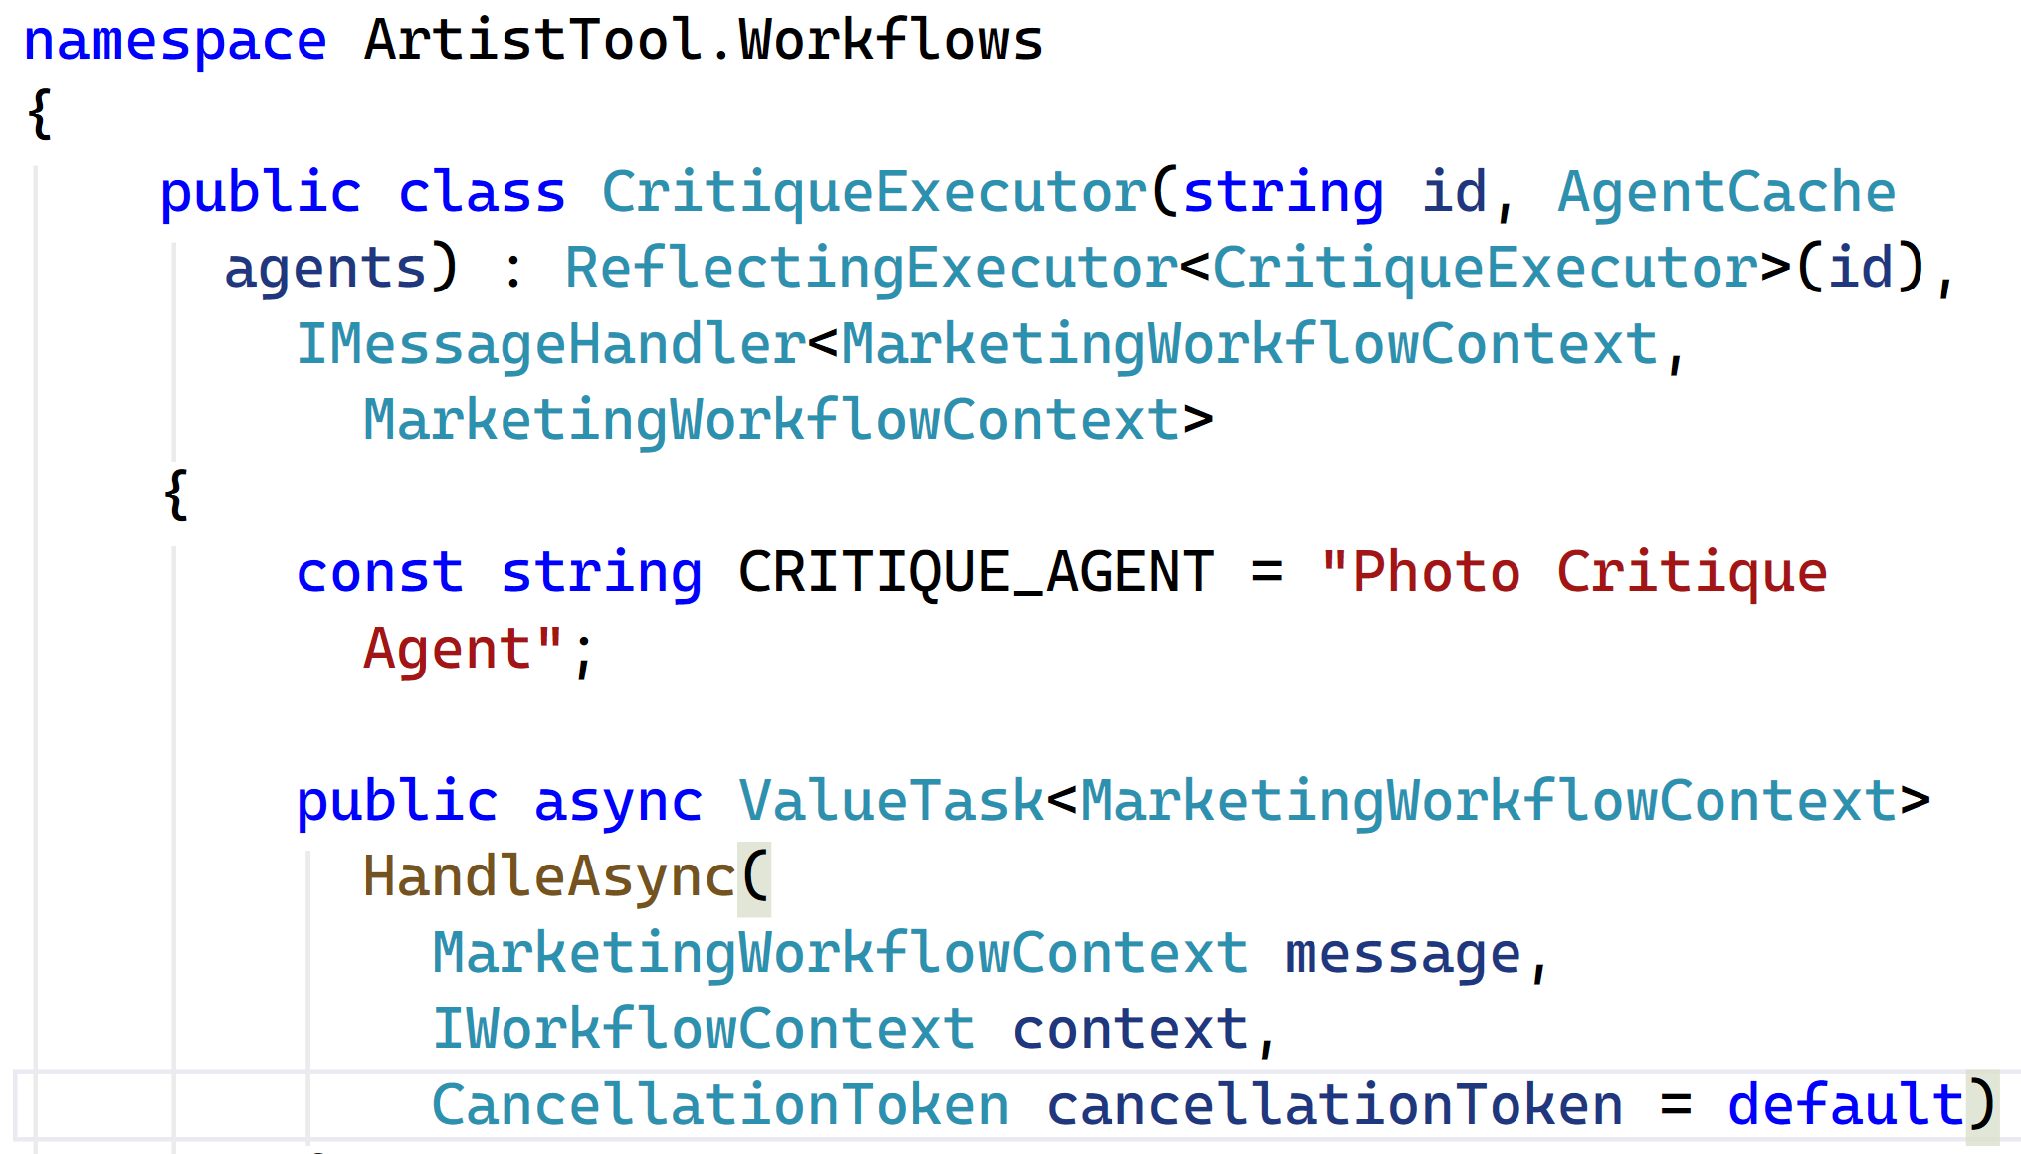

Slide 7
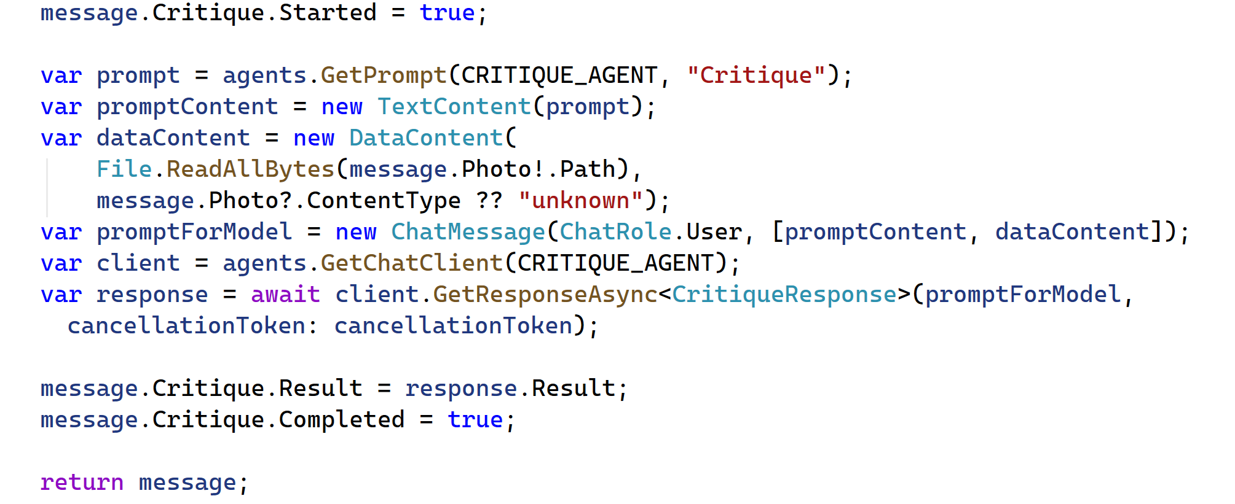

Slide 8
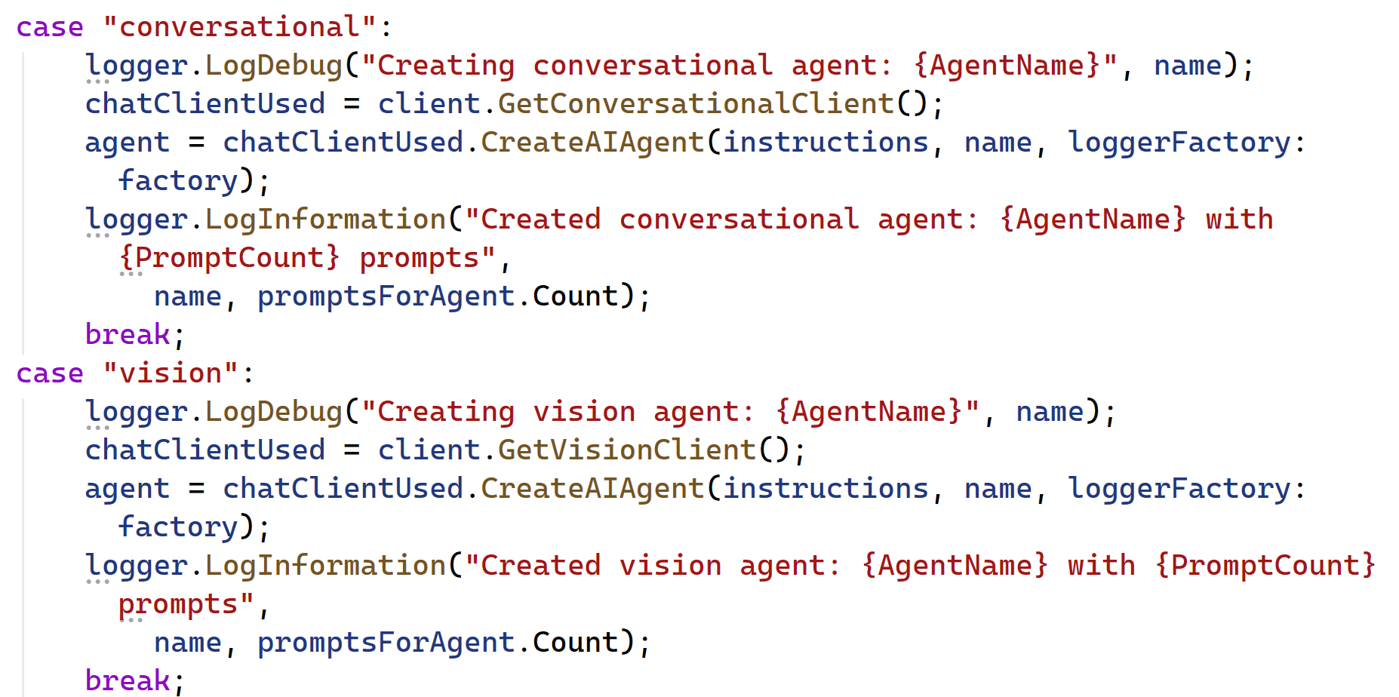

Slide 9
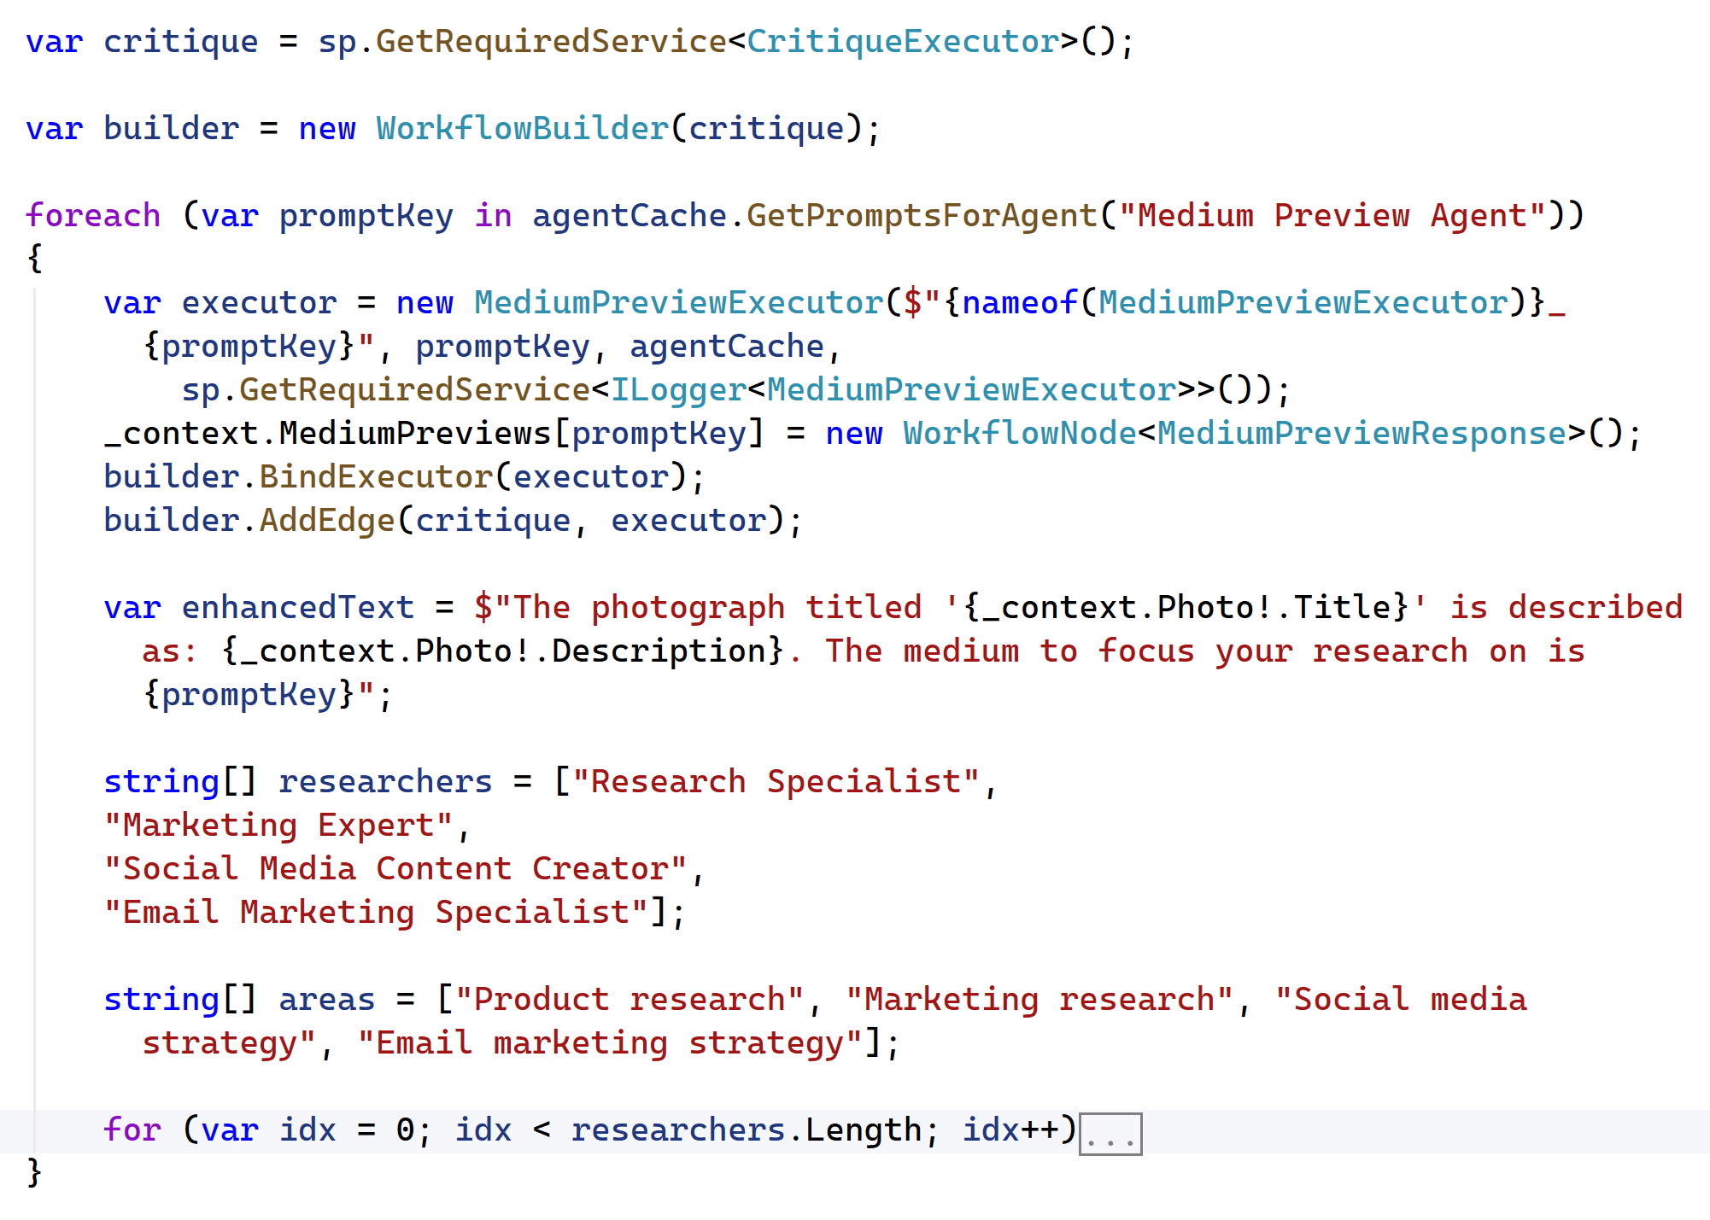

Slide 10
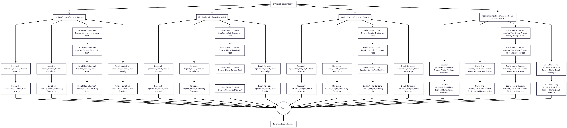

Slide 11
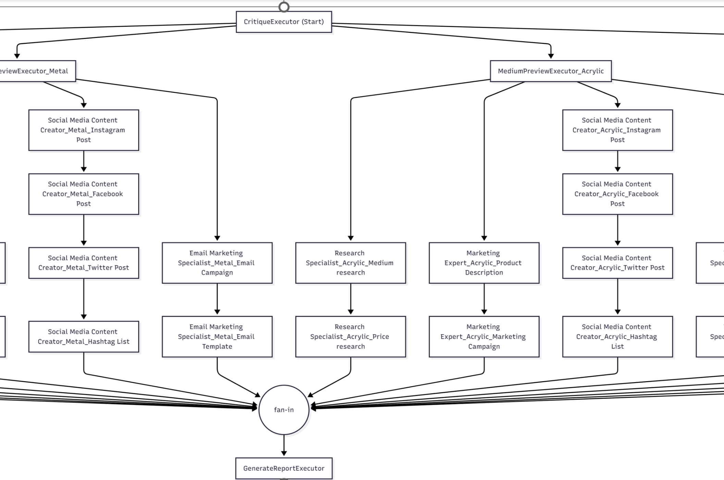

Slide 12
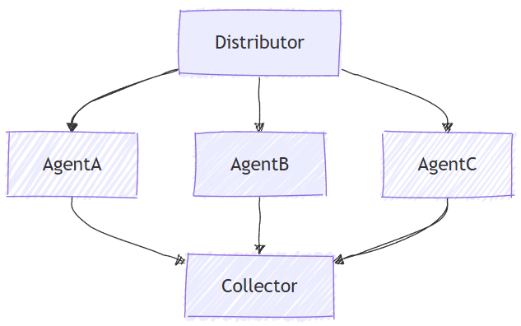

Slide 13
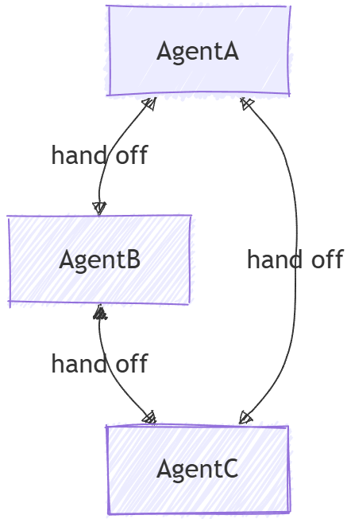
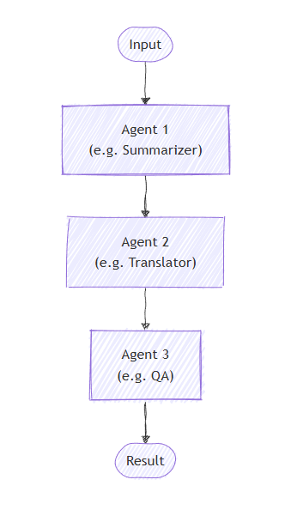

Slide 14
Agents as Executors
Workflows as Agents
Tools
MCP
Checkpoints

Slide 15
Resources
Agentic Development
https://learn.microsoft.com/dotnet/ai
https://learn.microsoft.com/dotnet/ai/microsoft-extensions-ai
https://github.com/microsoft/agent-framework
https://learn.microsoft.com/samples/dotnet/ai-samples/ai-samples
https://learn.mircosoft.com/dotnet/ai
https://github.com/JeremyLikness/ArtistTool/

Slide 16
Thank you

